Slide 1
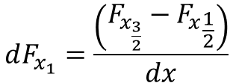

F_{1/2}
x₀
x_{1/2}
x₁
x_{3/2}
x₂
x_{5/2}
x₃
x_{7/2}
x₄
x₅
x₆
x₇
Flux calculated every ½ location from non ½ location
Compute
$$[ρ, ρu, ρE]$$
at ½ location. This is F
Normal vector to control volume
F_{in}
F_{out}
example
$$dF_{x_{1}}=\frac{\left(F_{x_{\frac{3}{2}}}−{F_{x}}_{\frac{1}{2}}\right)}{dx}$$
Kenji: Cell centered values then evaluate flux between the two cells
Then we integrate
Control Volume Approach

